Slide 1




MEE 428 Real Time Project
Serial Arm Control in Real Time
Mehmet Akif Demirlek
Mehmet Berke Parlat
Instructors
Özgün Başer

Slide 2



Introduction
The main purpose of the project is to create the necessary block diagram on Simulink, deploy it to Arduino with Simulink Support Package for Arduino Hardware, and drive a serial arm mechanism with two degrees of freedom. Also, observe the effects of adjusting PID parameters in real time using OptiTrack cameras in the end effector.

Slide 3
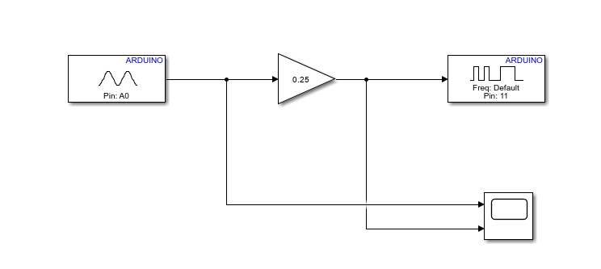
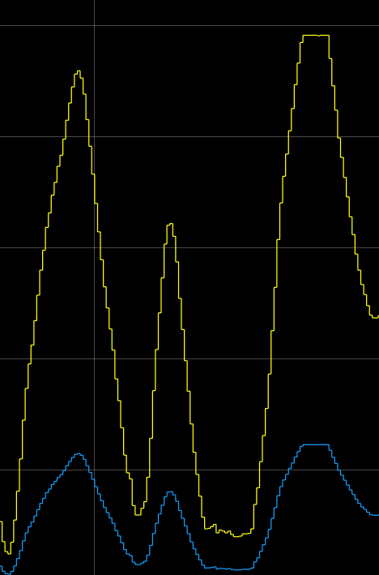
Simulink Design And Implementation
First, we controlled the velocity of the DC motor using a potentiometer. We converted the analog signal that we received from Arduino into a digital signal by multiplying it with 0.25 gain. Then, we observed that the motor velocity changed according to the magnitude of this digital signal.

Slide 4
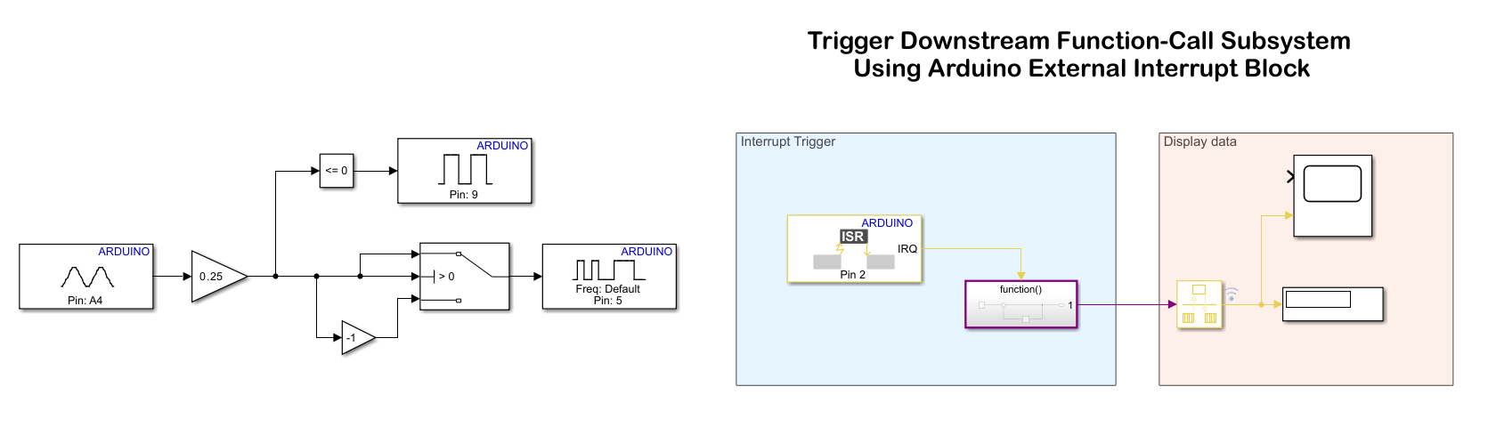
First of all, we controlled the direction and speed of the motor using a potentiometer. It was also used to count the encoder pulses of the dc motor with the external interrupt block.

Slide 5

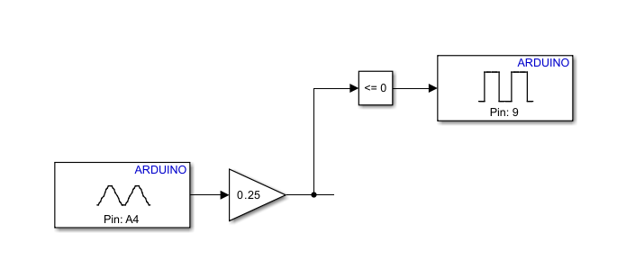


After converting the analog signal to digital signal, we compared this signal with the "compare to zero" block. This block checks whether the incoming signal is less than zero and the signal is sent to the Arduino digital output pin. If the compared signal is less than zero, the motor starts rotating in one direction (clockwise or counterclockwise); If the signal is greater than zero, the motor starts rotating in the other direction.

Slide 6
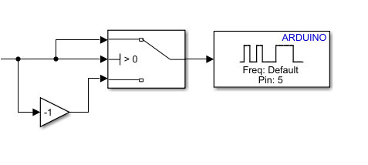
The switch block used here performs a kind of absolute value mathematical operation. In other words, it ensures that the incoming digital signal (negative or positive) passes through the switch block and comes out as a positive signal. This signal is sent to the PWM output of the motor and the speed of the motor is determined depending on the amplitude of the signal.

Slide 7
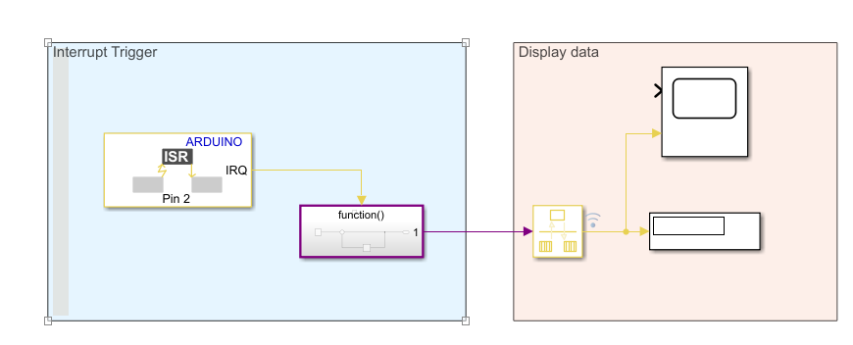

Here, we aimed to count the number of DC motor encoder pulses using the external interrupt block. At each rising edge, we counted the number of pulses with the subsystem within the Interrupt trigger block.

Slide 8
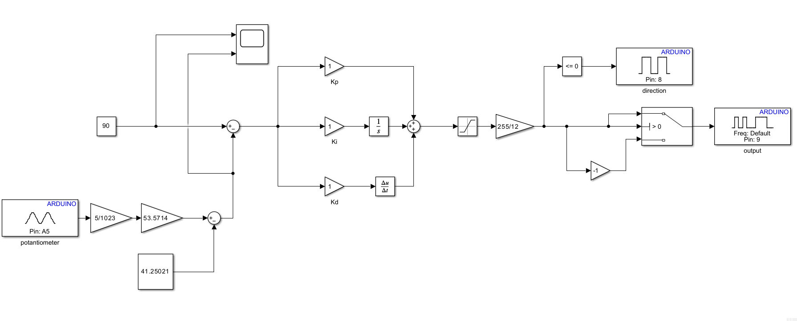
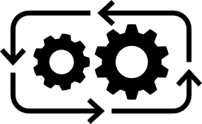
Here we used a rotary potentiometer that rotates synchronously with the rotation of the motor. This potentiometer acts as the feedback of the system. In addition, we wanted to ensure that the motor reaches the desired position with the least error and in the fastest way by evaluating the signal coming from the feedback with the PID controller.

Slide 9
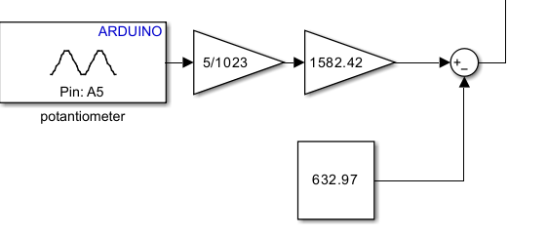

This is the feedback of the system. First, we converted the analog signal coming from the potentiometer output into a digital signal. Next, we added the voltage-degree calibration gains of the potentiometer. Thus, we observed what position the engine was in.

Slide 10
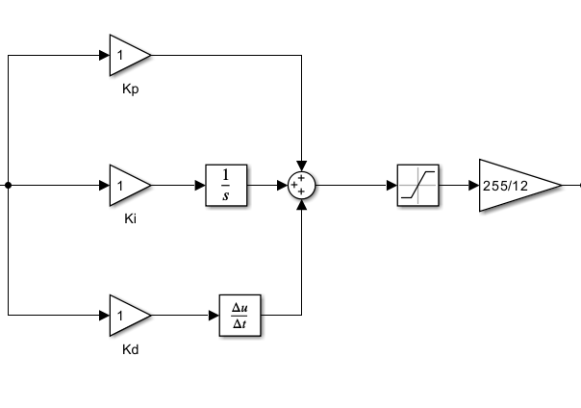
Here, we designed a PID controller that evaluates the error between the feedback signal from the potentiometer and the reference angle. Next, we converted the controller output signal to a PWM signal with a gain of 255/12.

Slide 11
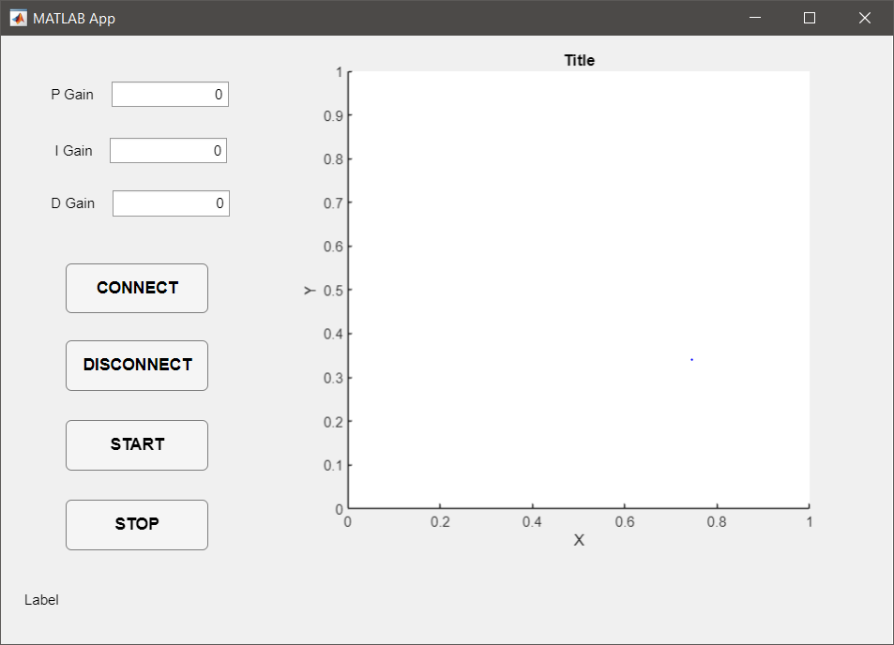
Here, we designed a a MATLAB App that has the ability to visualize the serial arm environment with reference path and real path, and ability to intervene the control gains in real-time.

Slide 12


THANKS FOR LISTENTING

